Slide 1


Software Design & System Design
An overview of Software Engineering
Otávio Santana, Founder
otavio@os.expert

Slide 2
Introduction
Software System
Software Design
Software Architecture
Software Design vs Software Architecture vs Software Design
Topics on this class

Slide 3
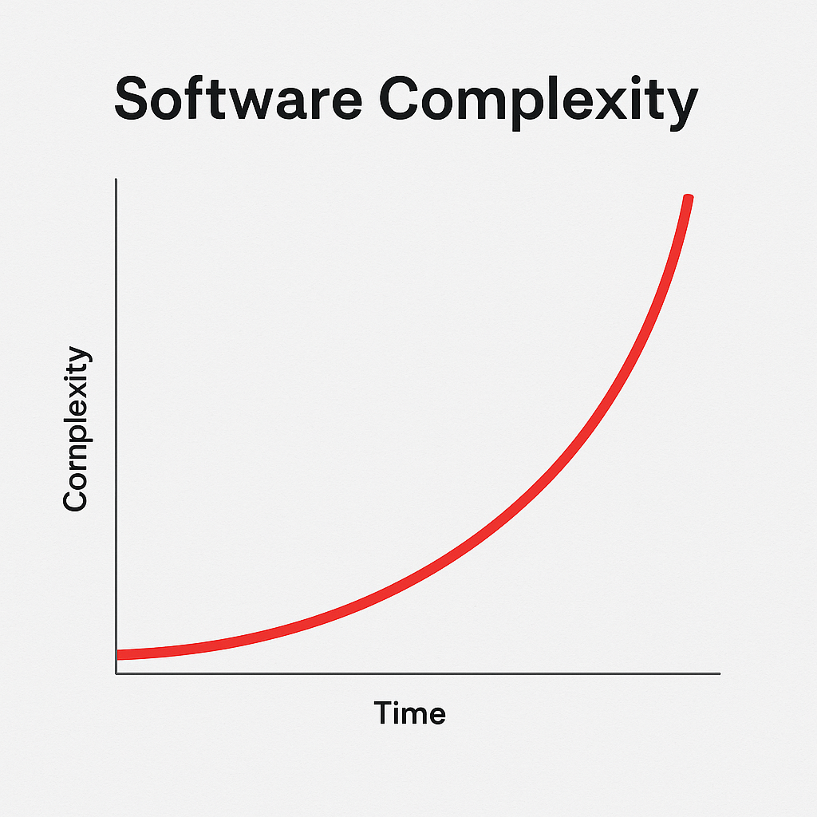

Software History
Software became more complex

Slide 4
Software History trend
Software became more complex
01
02
03
04
05
Hardware
Moore’s Law
Distributed Era
Team Scale
Accidental Complexity
Complexity was limited by hardware capacity
As hardware improved, developers were “allowed” to add more features, more layers, and serve more users.
Software distributed, it requires rely on CDNs, talk to databases, caches, queues, 3rd-party services, etc.
The code is not the problem. Coordinating people around it is.
Business domains are inherently complex. What hurts is accidental complexity.

Slide 5
Complexity with Layers and Tiers
Software became more complex
Layer: Presentation, Business Logic (Service), Data Access (DAO).
Tier: 3-tier (browser ↔ app server ↔ database).
1-tier architecture: UI + DB Mainframe era.
1960s–1970s
1999–2010
1980s–1990s
2010–present
Layer: UI on the client, business + DB logic often mixed in stored procedures or thick clients.
Tier: 2-tier (client ↔ database).
Layer: same as stage 3
Tier: N-tier

Slide 6
Why Do Software Systems Exist?
Software systems are strategic tools to manage complexity
4 Software Design
Dive into classes, objects, and their responsibilities.
1 Complexity Mapping
Understand the domain, stakeholders, inputs, and outcomes.
Software Engineering
3 Software Architecture
Choose structural patterns (layers, services, etc.)
Define boundaries and interactions between components.
2 Software System Planning
Model the system: what parts will it have? What responsibilities?
Software systems are the business strategy — not just the IT implementation.

Slide 7

Software Engineering
Definitions?
“Software engineering is the application of an empirical, scientific approach to finding efficient, economical solutions to practical problems in software.”

Slide 8
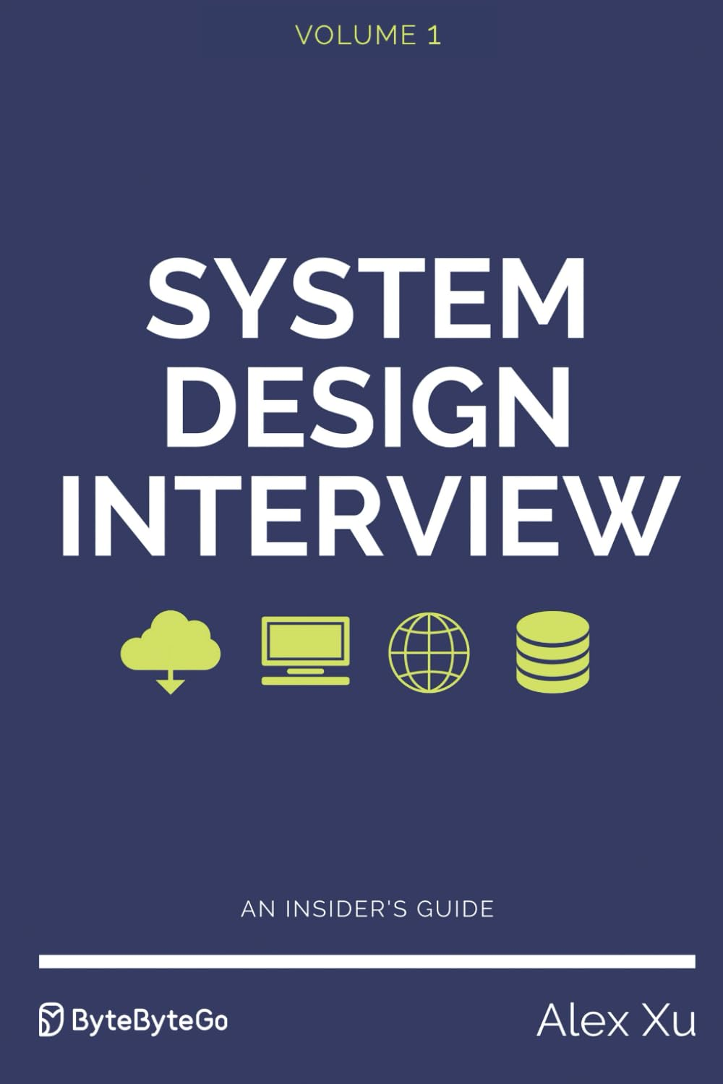
What Is a Software System?
A strategic solution to organize and automate complexity
“System design is the process of defining the architecture, components, modules, interfaces, and data for a system to satisfy specified requirements”
“The process of defining the architecture, components, interfaces, and behavior of a system to satisfy specified requirements.”
ISO/IEC/IEEE 42010

Slide 9


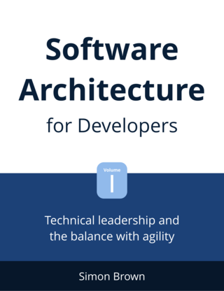
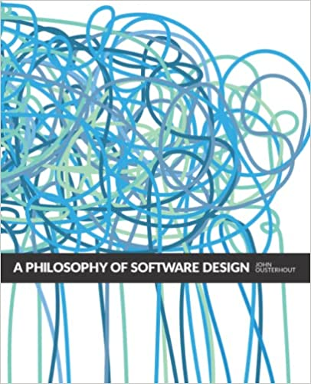



What is Software Architecture?
The strategic part of Software Development

Slide 10

Philosophy on Software Architecture
Technology, People, and Simplicity
Software architecture defines a system’s components, interactions, and principles. It balances technology and people—strategically guiding collaboration, scalability, adaptability, and efficiency to foster innovation and maintainability with simplicity.

Slide 11

People
Software with people through people
Bias: Complexity, Choice paradox and Broken windows theory
Culture: Quality and avoid complexity.
Structure: Conway's law

Slide 12


Why do we need architecture?
Technology, People, and Simplicity
A single point of failure
Culture
Methodology
Technology

Slide 13


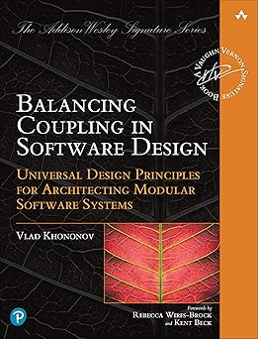

What is Software Design?
The tactic part of Software Development
“Design is about assigning responsibilities to the right classes, in the right way, for the right reasons.”

Slide 14

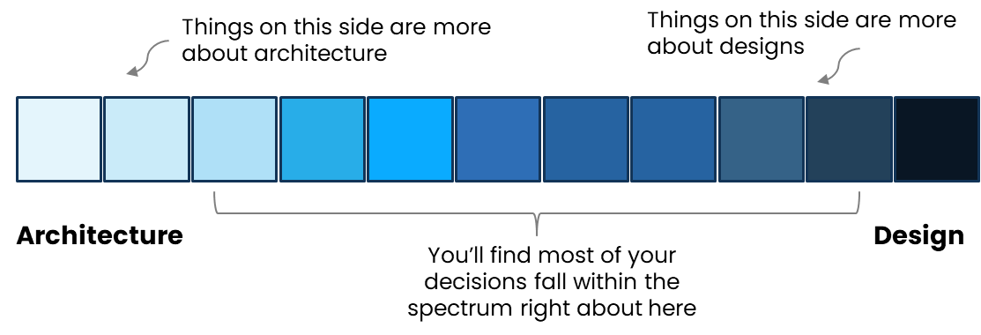
Architecture vs Design
The boundaries to DDD

Slide 15
Architecture, Design, and System Design
Three levels of structure, three kinds of complexity
Dimension | System Design | Software Architecture | Software Design
Role | Planner | Strategist | Tactician
Focus | Business goals, scale, constraints | Structure, components, boundaries | Implementation, logic, patterns
Scope | Entire ecosystem / product | One system or service | One module or feature
Main Questions | What should the system do? At what scale? | What are the major parts and how do they talk? | How should each part work internally?
Stakeholders | CTO, architects, product, SREs | Architects, leads, developers | Developers, tech leads
Nature | Planning / Problem framing | Strategic structuring | Tactical implementation

Slide 16


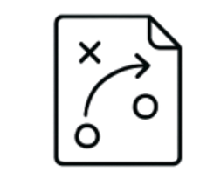
Architecture, Design, and System Design
Summary
System Design frames the problem and constraints.
System
Design
Software Architecture
Design brings those structures to life in working code.
Architecture structures the system to meet those constraints.
Software
Design

